Slide 1



Python Bootcamp A simple plot
PhD Bruno C. Quint
bquint@ctio.noao.edu
Resident Astronomer at SOAR Telescope
https://github.com/b1quint/Python-Tutorial-Series

Slide 2
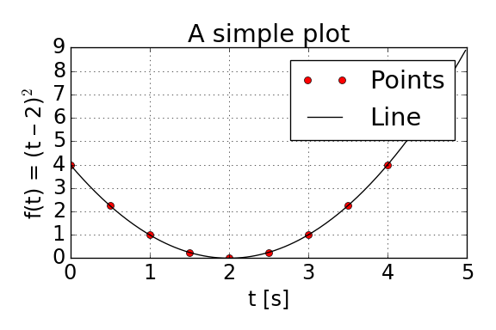
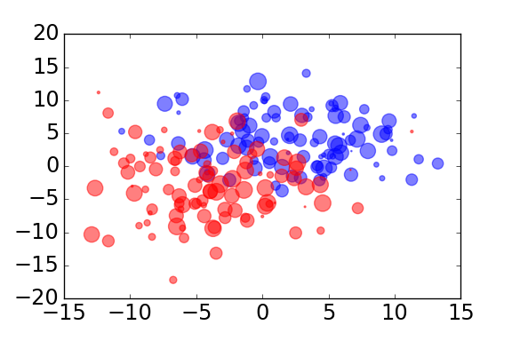
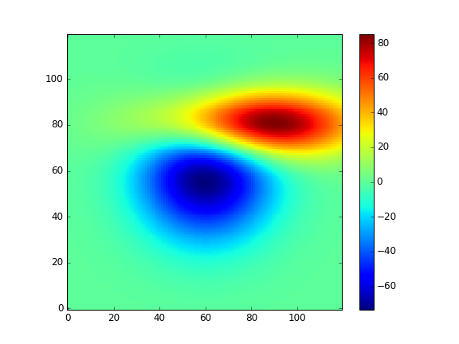
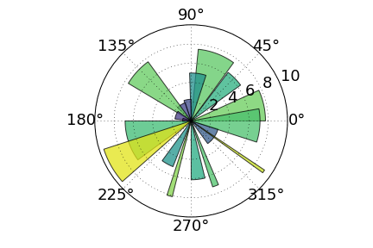
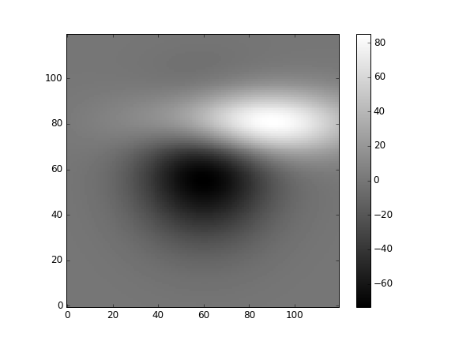
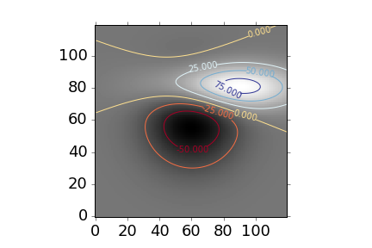
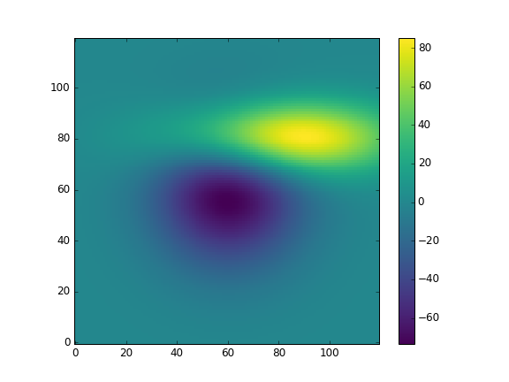
Table of Contents
A simple plot
Types of plots
Different styles

Slide 3
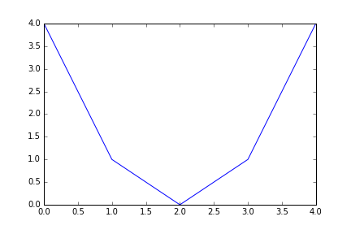
A simple plot My First Example
from matplotlib.pyplot import *
x = [0, 1, 2, 3, 4]
y = [4, 1, 0, 1, 4]
plot(x, y)
show()

Slide 4
A simple plot Save the Image!
from matplotlib.pyplot import *
x = [0, 1, 2, 3, 4]
y = [4, 1, 0, 1, 4]
plot(x, y)
savefig(‘plot_001A.png’)

Slide 5
A simple plot Save the Image!
from matplotlib.pyplot import *
x = [0, 1, 2, 3, 4]
y = [4, 1, 0, 1, 4]
plot(x, y)
savefig(‘plot_001A.png’, dpi=96)

Slide 6
A simple plot Let’s do it the “right” way
import matplotlib.pyplot as plt
x = [0, 1, 2, 3, 4]
y = [4, 1, 0, 1, 4]
plt.plot(x, y)
plt.show()

Slide 7
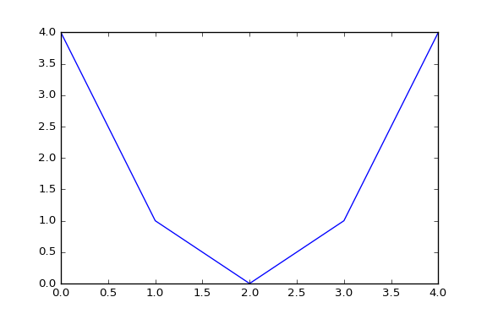
A simple plot Let’s do it the “right” way
import matplotlib.pyplot as plt
import numpy as np
x = np.arange(5)
y = (x – 2) ** 2
plt.plot(x, y)
plt.show()

Slide 8
A simple plot Plot and plot again…
x = np.arange(5)
y = x ** 2 – 4 * x + 4
plt.plot(x, y)

Slide 9
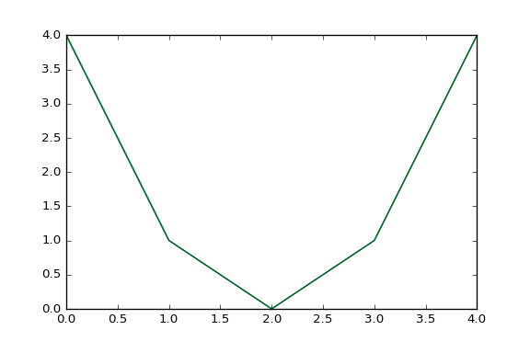
A simple plot Plot and plot again…
x = np.arange(5)
y = x ** 2 – 4 * x + 4
plt.plot(x, y)
plt.plot(x, y)

Slide 10
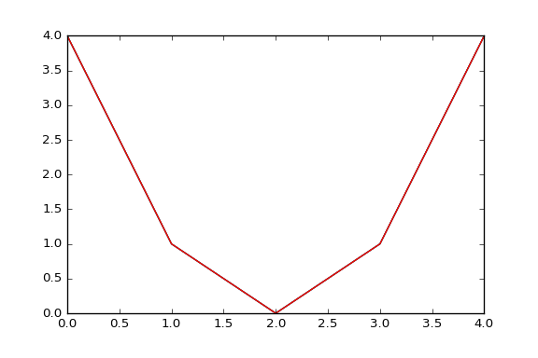
A simple plot Plot and plot again…
x = np.arange(5)
y = x ** 2 – 4 * x + 4
plt.plot(x, y)
plt.plot(x, y)
plt.plot(x, y)

Slide 11
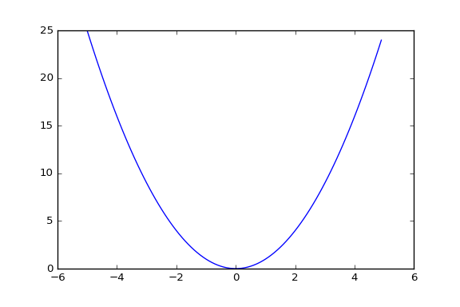
A simple plot Let’s do it the “right” way
import matplotlib.pyplot as plt
import numpy as np
x = np.arange(-5, 5, 0.1)
y = (x – 2) ** 2
plt.plot(x, y)
plt.show()

Slide 12
A simple plot Let’s do it the “right” way
import matplotlib.pyplot as plt
import numpy as np
x = np.arange(-5, 5, 0.1)
y = (x – 2) ** 2
plt.plot(x, y)
plt.show()

Slide 13
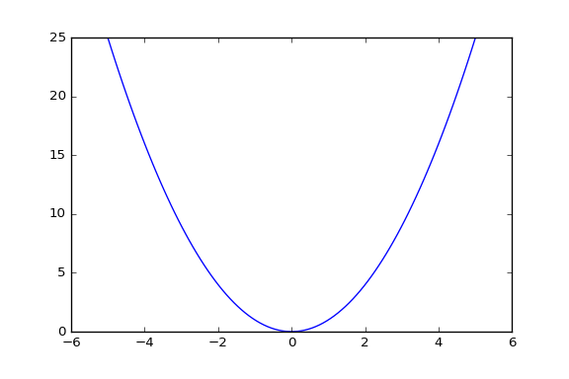
A simple plot Let’s do it the “right” way
import matplotlib.pyplot as plt
import numpy as np
x = np.linspace(-5, 5, 100)
y = (x – 2) ** 2
plt.plot(x, y)
plt.show()

Slide 14
A simple plot Plot with style
def f(t):
return (t - 2) ** 2

Slide 15
A simple plot Plot with style
def f(t):
return (t - 2) ** 2
t1 = np.arange(0.0, 5.0, 0.5)
t2 = np.arange(0.0, 5.0, 0.02)

Slide 16
A simple plot Plot with style
def f(t):
return (t - 2) ** 2
t1 = np.arange(0.0, 5.0, 0.5)
t2 = np.arange(0.0, 5.0, 0.02)
plt.plot(t1, f(t1), 'ro’)
plt.plot(t2, f(t2), 'k')

Slide 17
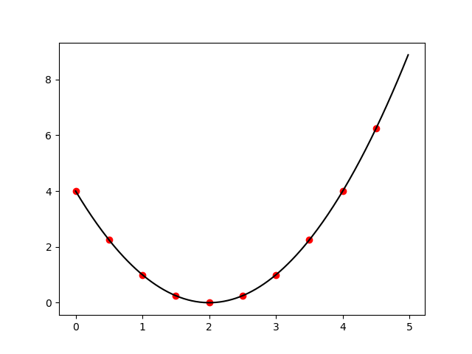
A simple plot Plot with style
def f(t):
return (t - 2) ** 2
t1 = np.arange(0.0, 5.0, 0.5)
t2 = np.arange(0.0, 5.0, 0.02)
plt.plot(t1, f(t1), 'ro', t2, f(t2), 'k')

Slide 18
A simple plot Plot with style
def f(t):
return (t - 2) ** 2
t1 = np.arange(0.0, 5.0, 0.5)
t2 = np.arange(0.0, 5.0, 0.02)
plt.plot(t1, f(t1), 'ro’, t2, f(t2), 'k')

Slide 19
A simple plot Plot with style
def f(t):
return (t - 2) ** 2
t1 = np.arange(0.0, 5.0, 0.5)
t2 = np.arange(0.0, 5.0, 0.02)
plt.plot(t1, f(t1), 'ro', t2, f(t2), 'k')

Slide 20
A simple plot Plot with style
def f(t):
return (t - 2) ** 2
t1 = np.arange(0.0, 5.0, 0.5)
t2 = np.arange(0.0, 5.0, 0.02)
plt.plot(t2, f(t2), 'k')
plt.plot(t1, f(t1), 'ro’)

Slide 21

A simple plot Plot with style
def f(t):
return (t - 2) ** 2
t1 = np.arange(0.0, 5.0, 0.5)
t2 = np.arange(0.0, 5.0, 0.02)
plt.plot(t1, f(t1), 'ro', t2, f(t2), 'k')

Slide 22
A simple plot Plot with style
def f(t):
return (t - 2) ** 2
t1 = np.arange(0.0, 5.0, 0.5)
t2 = np.arange(0.0, 5.0, 0.02)
plt.plot(t1, f(t1), 'ro', t2, f(t2), 'k')
plt.xlabel(“t [s]”)
plt.ylabel(u"f(t) = (t – 2)$^2$")

Slide 23
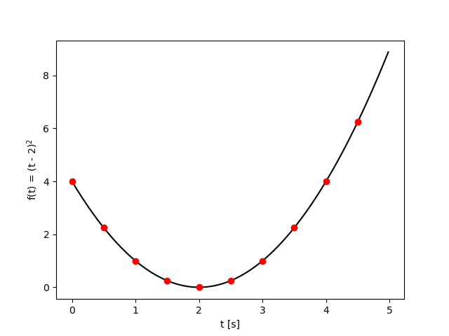
A simple plot Plot with style
def f(t):
return (t - 2) ** 2
t1 = np.arange(0.0, 5.0, 0.5)
t2 = np.arange(0.0, 5.0, 0.02)
plt.plot(t1, f(t1), 'ro', t2, f(t2), 'k')
plt.xlabel(“t [s]”)
plt.ylabel(u"f(t) = (t – 2)$^2$")

Slide 24
A simple plot Plot with style
def f(t):
return (t - 2) ** 2
t1 = np.arange(0.0, 5.0, 0.5)
t2 = np.arange(0.0, 5.0, 0.02)
plt.plot(t1, f(t1), 'ro', t2, f(t2), 'k')
plt.xlabel(“t [s]”, fontsize=24)
plt.ylabel(u"f(t) = (t – 2)$^2$”,
fontsize=24)

Slide 25
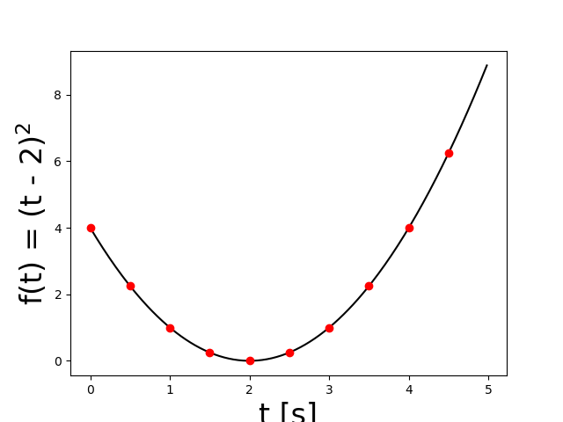
A simple plot Plot with style
def f(t):
return (t - 2) ** 2
t1 = np.arange(0.0, 5.0, 0.5)
t2 = np.arange(0.0, 5.0, 0.02)
plt.plot(t1, f(t1), 'ro', t2, f(t2), 'k')
plt.xlabel(“t [s]”, fontsize=24)
plt.ylabel(u"f(t) = (t – 2)$^2$”,
fontsize=24)

Slide 26
A simple plot Plot with style
def f(t):
return (t - 2) ** 2
t1 = np.arange(0.0, 5.0, 0.5)
t2 = np.arange(0.0, 5.0, 0.02)
plt.plot(t1, f(t1), 'ro', t2, f(t2), 'k')
plt.xlabel(“t [s]”, fontsize=24)
plt.ylabel(u"f(t) = (t – 2)$^2$”,
fontsize=24)
plt.xticks(fontsize=18)

Slide 27
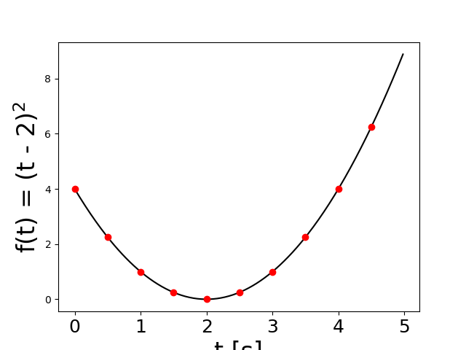
A simple plot Plot with style
def f(t):
return (t - 2) ** 2
t1 = np.arange(0.0, 5.0, 0.5)
t2 = np.arange(0.0, 5.0, 0.02)
plt.plot(t1, f(t1), 'ro', t2, f(t2), 'k')
plt.xlabel(“t [s]”, fontsize=24)
plt.ylabel(u"f(t) = (t – 2)$^2$”,
fontsize=24)

Slide 28
A simple plot Plot with style
>>> import matplotlib as mpl
>>> print mpl.rcParams['font.size']
10
>>> mpl.rcParams['font.size'] = 18
>>> plt.plot(t1, f(t1), 'ro')
>>> plt.plot(t2, f(t2), 'k')
>>> plt.xlabel('t [s]')
>>> plt.ylabel(u’f(t) = (t – 2)$^s$’)

Slide 29
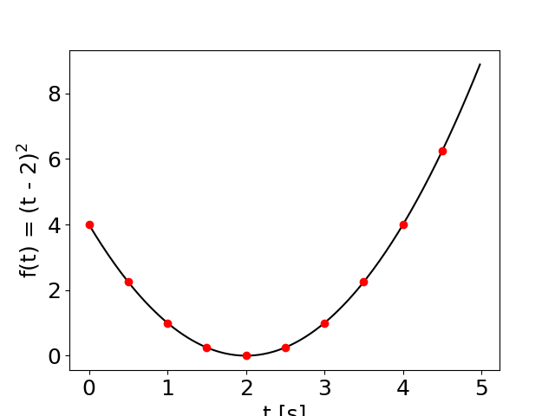
A simple plot Plot with style
>>> import matplotlib as mpl
>>> print mpl.rcParams['font.size']
10
>>> mpl.rcParams['font.size'] = 18
>>> plt.plot(t1, f(t1), 'ro')
>>> plt.plot(t2, f(t2), 'k')
>>> plt.xlabel('t [s]')
>>> plt.ylabel(u’f(t) = (t – 2)$^s$’)

Slide 30
A simple plot Plot with style
>>> plt.title(“A simple plot”)

Slide 31
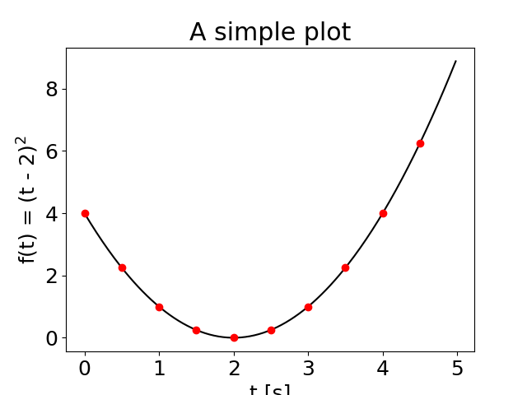
A simple plot Plot with style
>>> plt.title(“A simple plot”)

Slide 32
A simple plot Plot with style
>>> plt.grid()

Slide 33
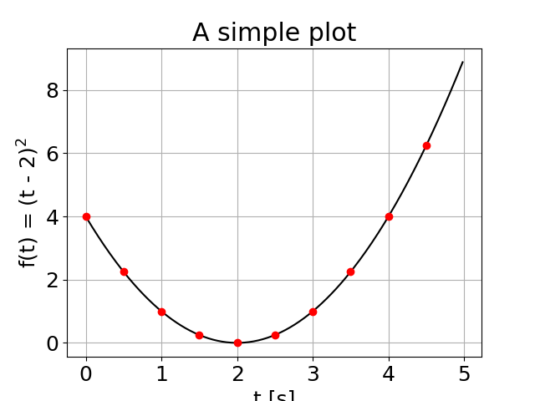
A simple plot Plot with style
>>> plt.grid()

Slide 34
A simple plot Plot with style
>>> plt.plot(t1, f(t1), 'ro', label="Points")
>>> plt.plot(t2, f(t2), 'k', label="Line")
>>> plt.legend()

Slide 35
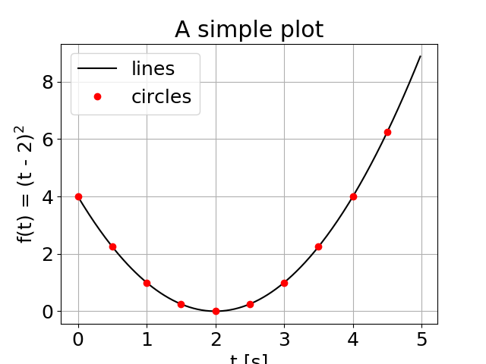
A simple plot Plot with style
>>> plt.plot(t1, f(t1), 'ro', label="Points")
>>> plt.plot(t2, f(t2), 'k', label="Line")
>>> plt.legend()

Slide 36
A simple plot Plot with style
>>> plt.plot(t1, f(t1), 'ro', label="Points")
>>> plt.plot(t2, f(t2), 'k', label="Line")
>>> plt.legend()
>>> plt.tight_layout()

Slide 37
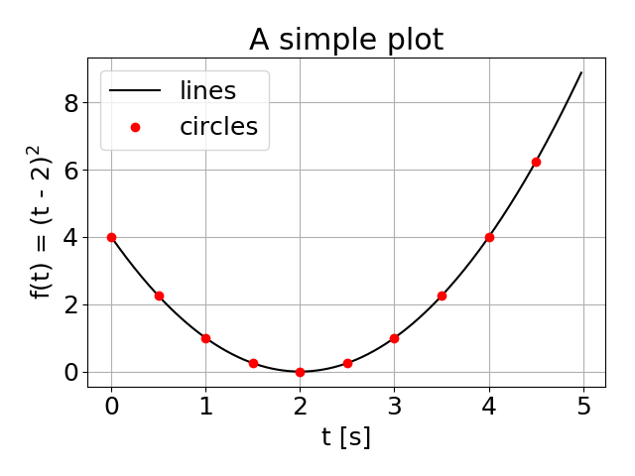
A simple plot Plot with style
>>> plt.tight_layout()

Slide 38
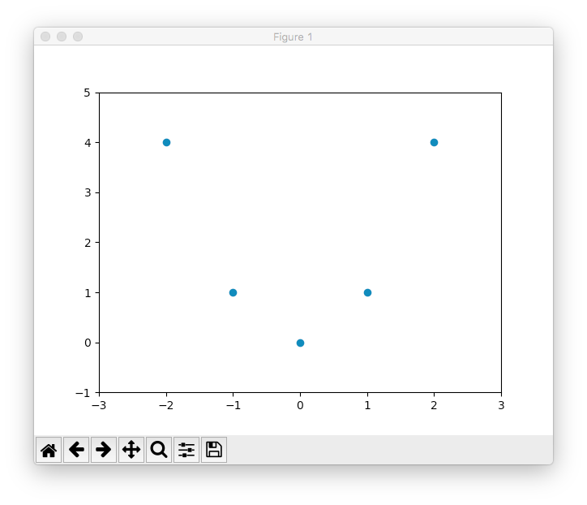
A good practice
x = np.arange(5) - 2
y = x ** 2
fig = plt.figure()
ax = fig.add_subplot(111)
ax.plot(x, y, ‘o’)
ax.set_xlim(-3, 3)
ax.set_ylim(-1, 5)
plt.show()

Slide 39

A good practice
x = np.arange(5) - 2
y = x ** 2
fig = plt.figure(num=“My_Figure”)
ax = fig.add_subplot(111)
ax.plot(x, y, ‘o’)
ax.set_xlim(-3, 3)
ax.set_ylim(-1, 5)
plt.show()

Slide 40
A good practice
x = np.arange(5) - 2
y = x ** 2
fig = plt.figure(num=“My_Figure”)
ax = fig.add_subplot(111)
ax.plot(x, y, ‘o’)
ax.set_xlim(-3, 3)
ax.set_ylim(-1, 5)
plt.show()

Slide 41
A good practice
x = np.arange(5) - 2
y = x ** 2
fig = plt.figure(num=“My_Figure”)
ax = fig.add_subplot(111)
ax.plot(x, y, ‘o’)
ax.set_xlim(-3, 3)
ax.set_ylim(-1, 5)
plt.show()

Slide 42
A good practice
x = np.arange(5) - 2
y = x ** 2
fig = plt.figure(num=“My_Figure”)
ax = fig.add_subplot(111)
ax.plot(x, y, ‘o’)
ax.set_xlim(-3, 3)
ax.set_ylim(-1, 5)
plt.show()

Slide 43
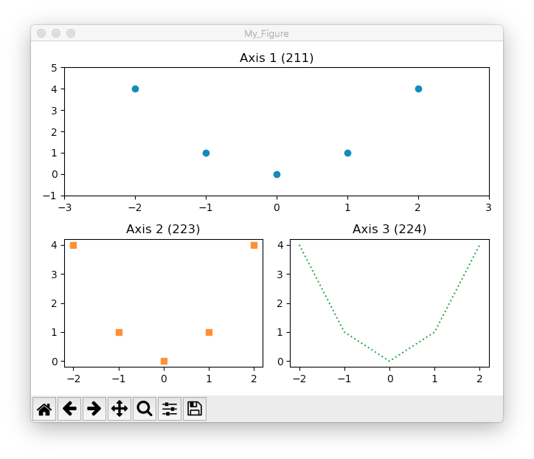
A good practice
fig = plt.figure()
ax1 = fig.add_subplot(211)
ax2 = fig.add_subplot(223)
ax3 = fig.add_subplot(224)
ax1.plot(x, y, "C0o")
ax1.set_title("Axis 1 (211)")
ax2.plot(x, y, "C1s")
ax2.set_title("Axis 2 (223)")
ax3.plot(x, y, "C2:")
ax3.set_title("Axis 3 (224)")

Slide 44
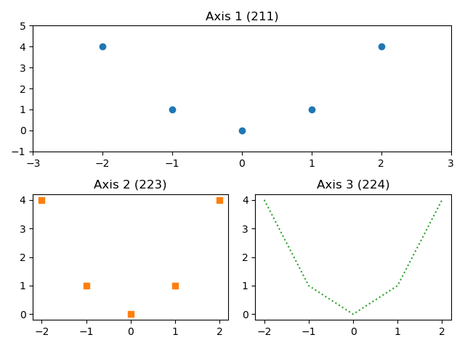
Figures and Axes
Figure

Slide 45
Figures and Axes
1 column
2 rows

Slide 46
Figures and Axes
1 column
211
2 rows
212

Slide 47
Figures and Axes
2 columns
221
222
2 rows
223
224

Slide 48
Plot with style
def f(t):
return (t - 2.) ** 2.
t1 = np.arange(0.0, 5.0, 0.5)
t2 = np.arange(0.0, 5.0, 0.02)
plt.plot(t2, f(t2), 'C0-', label="lines")
plt.plot(t1, f(t1), 'C1o', label="circles")
plt.title("A simple plot")
plt.grid()
plt.legend()
plt.tight_layout()
plt.savefig('fig_ex4a.png')

Slide 49
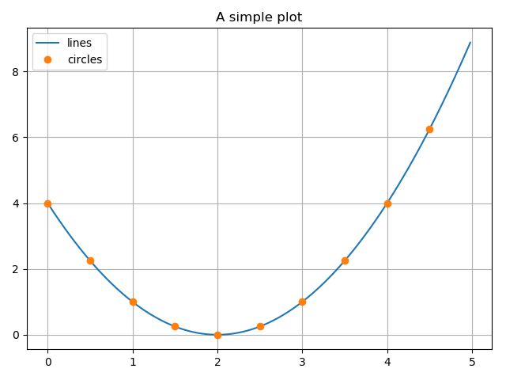
Plot with style
def f(t):
return (t - 2.) ** 2.
t1 = np.arange(0.0, 5.0, 0.5)
t2 = np.arange(0.0, 5.0, 0.02)
plt.plot(t2, f(t2), 'C0-', label="lines")
plt.plot(t1, f(t1), 'C1o', label="circles")
plt.title("A simple plot")
plt.grid()
plt.legend()
plt.tight_layout()
plt.savefig('fig_ex4a.png')

Slide 50
Plot with style
def f(t):
return (t - 2.) ** 2.
t1 = np.arange(0.0, 5.0, 0.5)
t2 = np.arange(0.0, 5.0, 0.02)
plt.style.use(‘seaborn’)
plt.plot(t2, f(t2), 'C0-', label="lines")
plt.plot(t1, f(t1), 'C1o', label="circles")
plt.title("A simple plot")
plt.grid()
plt.legend()
plt.tight_layout()
plt.savefig('fig_ex4a.png')

Slide 51
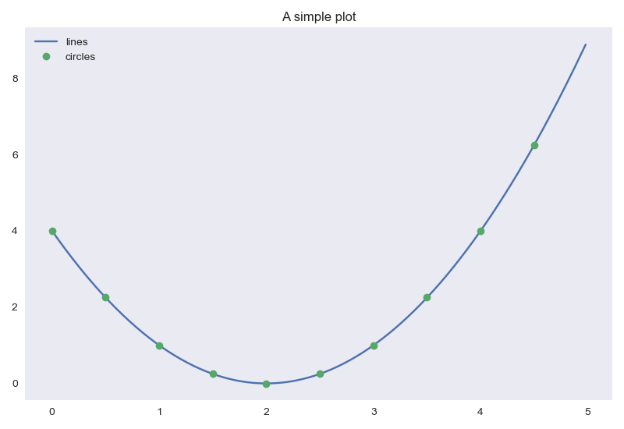
Plot with style
def f(t):
return (t - 2.) ** 2.
t1 = np.arange(0.0, 5.0, 0.5)
t2 = np.arange(0.0, 5.0, 0.02)
plt.style.use(‘seaborn’)
plt.plot(t2, f(t2), 'C0-', label="lines")
plt.plot(t1, f(t1), 'C1o', label="circles")
plt.title("A simple plot")
plt.grid()
plt.legend()
plt.tight_layout()
plt.savefig('fig_ex4a.png')

Slide 52
Plot with style
def f(t):
return (t - 2.) ** 2.
t1 = np.arange(0.0, 5.0, 0.5)
t2 = np.arange(0.0, 5.0, 0.02)
plt.style.use(‘grayscale’)
plt.plot(t2, f(t2), 'C0-', label="lines")
plt.plot(t1, f(t1), 'C1o', label="circles")
plt.title("A simple plot")
plt.grid()
plt.legend()
plt.tight_layout()
plt.savefig('fig_ex4a.png')

Slide 53
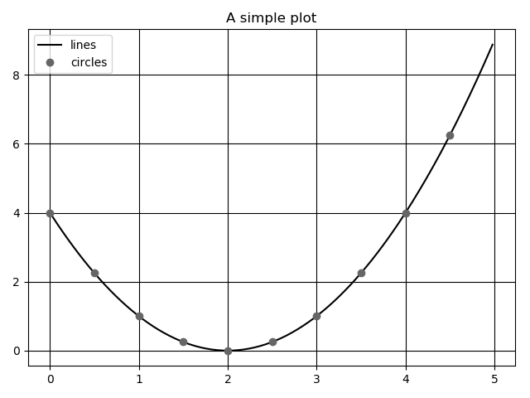
Plot with style
def f(t):
return (t - 2.) ** 2.
t1 = np.arange(0.0, 5.0, 0.5)
t2 = np.arange(0.0, 5.0, 0.02)
plt.style.use(‘seaborn’)
plt.plot(t2, f(t2), 'C0-', label="lines")
plt.plot(t1, f(t1), 'C1o', label="circles")
plt.title("A simple plot")
plt.grid()
plt.legend()
plt.tight_layout()
plt.savefig('fig_ex4a.png')

Slide 54
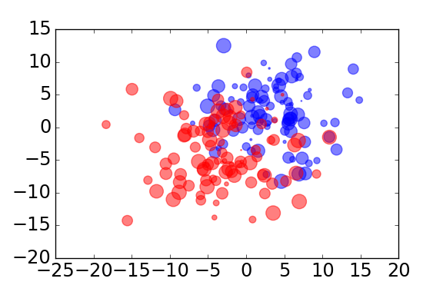
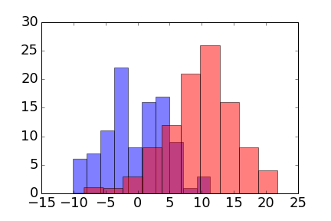
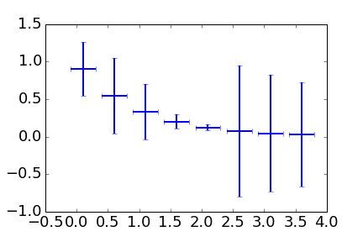
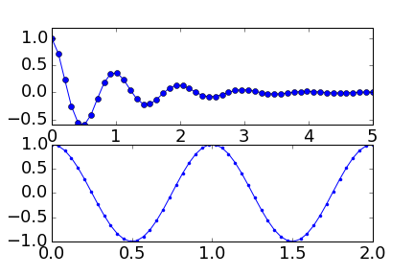
Types of plots
Scatter Plot
Histogram
Errorbar Plots
Multiple Axis

Slide 55
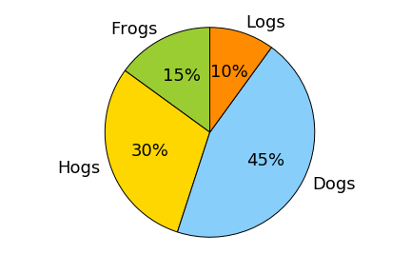
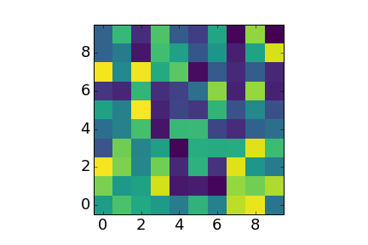
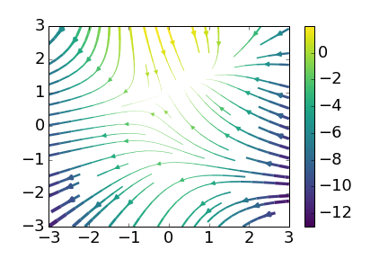
Types of plots
Pie Plots
Polar Plots
Display Images
Stream Plots

Slide 56
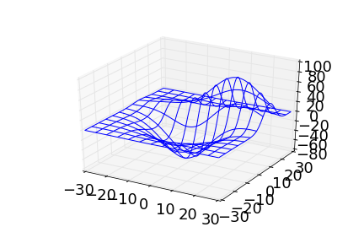
Types of plots
Plots 3D
Contour Plots

Slide 57
Colormaps
jet

Slide 58
Colormaps
grayscale

Slide 59
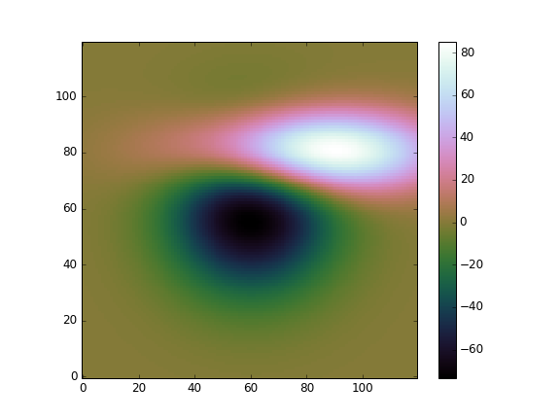
Colormaps
cubehelix

Slide 60
Colormaps
viridis

Slide 61
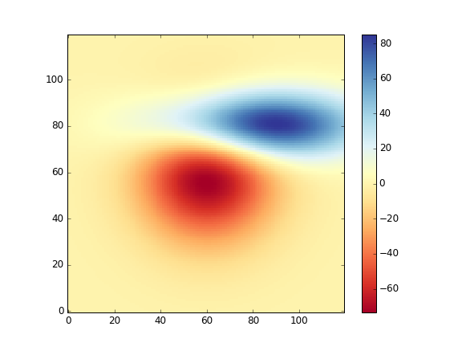
Colormaps
RdYlBu

Slide 62

Questions?

